Slide 1
ECG Monitor
Single Lead Analog
Heart Rate Monitor

Slide 2
ECG Waveform

Slide 3
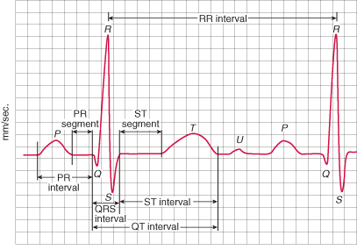
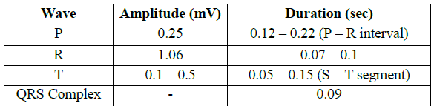
ECG Monitor
ECG Waveform

Slide 4
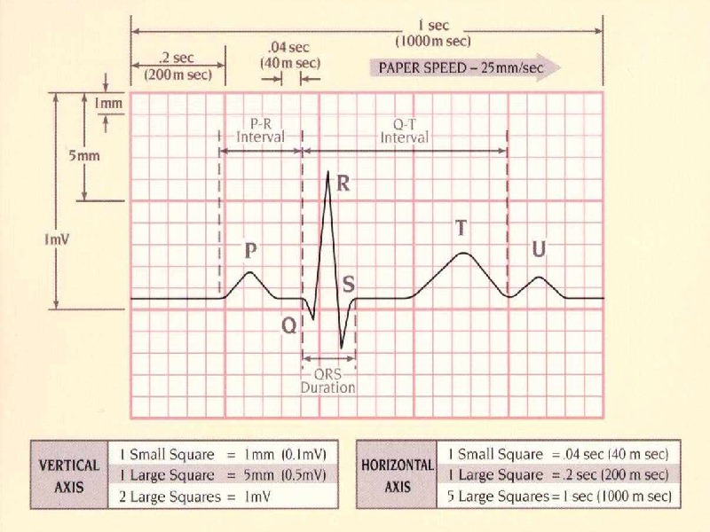
ECG Monitor
ECG Waveform

Slide 5
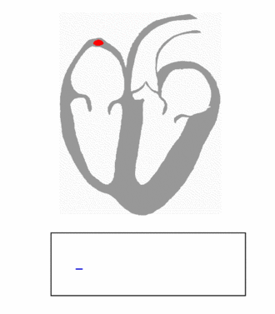
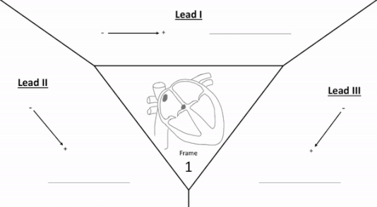
ECG Monitor
ECG Waveform
Electrocardiography - Wikipedia
Animation of a normal ECG wave
Formation of limb waveforms during a pulse

Slide 6
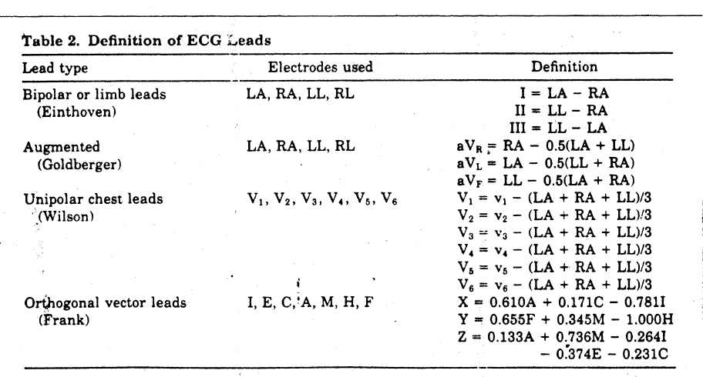
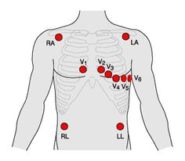
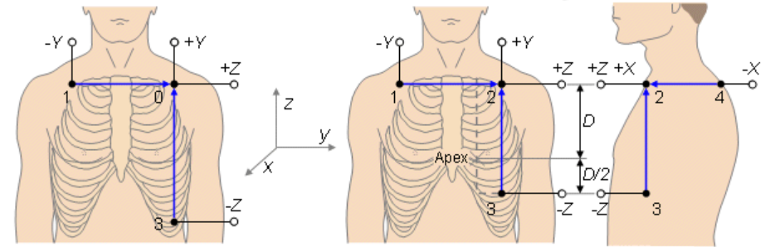
ECG Monitor
ECG Leads

Slide 7
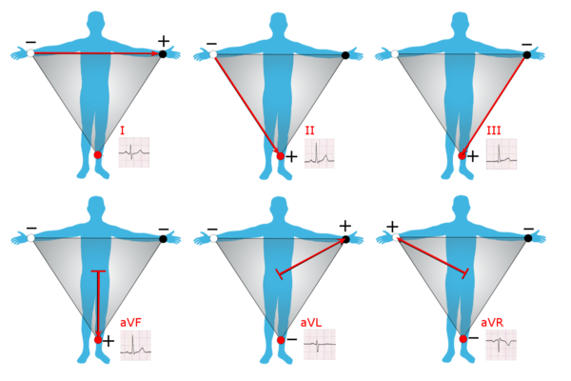
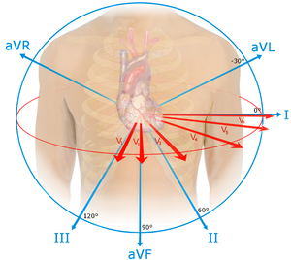
ECG Monitor
ECG Leads
Electrocardiography - Wikipedia
The limb leads and augmented limb leads (Wilson's central terminal is used as the negative pole for the latter in this representation)

Slide 8
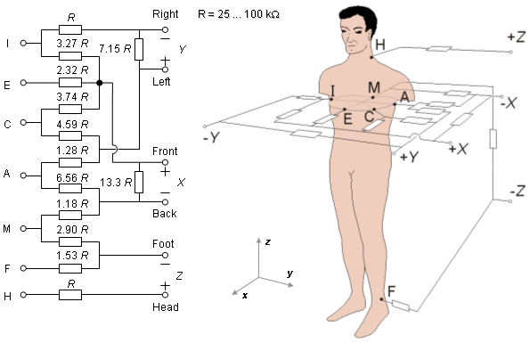
ECG Monitor
ECG Leads
16. Vectorcardiographic Lead Systems (bem.fi)
The lead matrix of the Frank VCG-system. The electrodes are marked I, E, C, A, M, F, and H, and their anatomical positions are shown. The resistor matrix results in the establishment of normalized x-, y-, and z-component lead vectors, as described in the text.

Slide 9
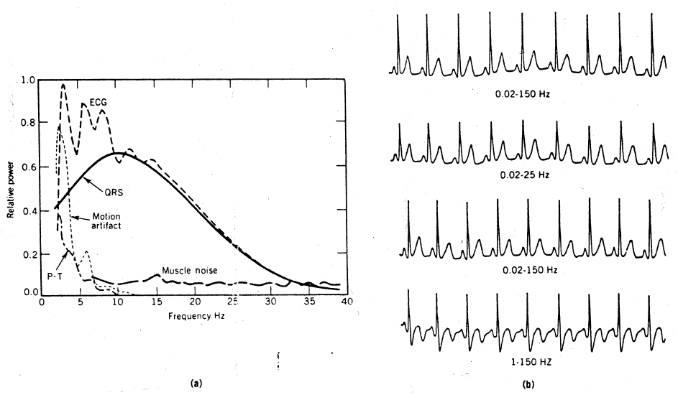
ECG Monitor
ECG Espectra

Slide 10
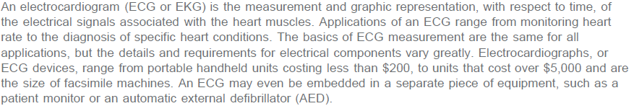
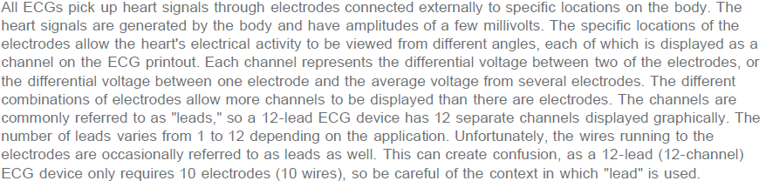
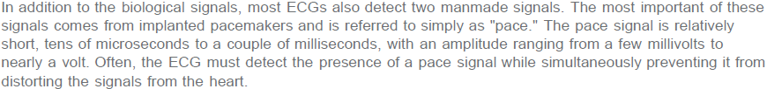
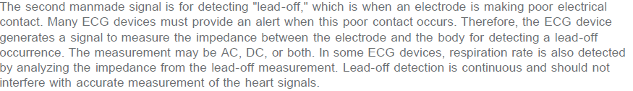
ECG Monitor
Introduction to Electrocardiograph, Maxim AN4693
https://www.maximintegrated.com/en/app-notes/index.mvp/id/4693
Overview

Slide 11
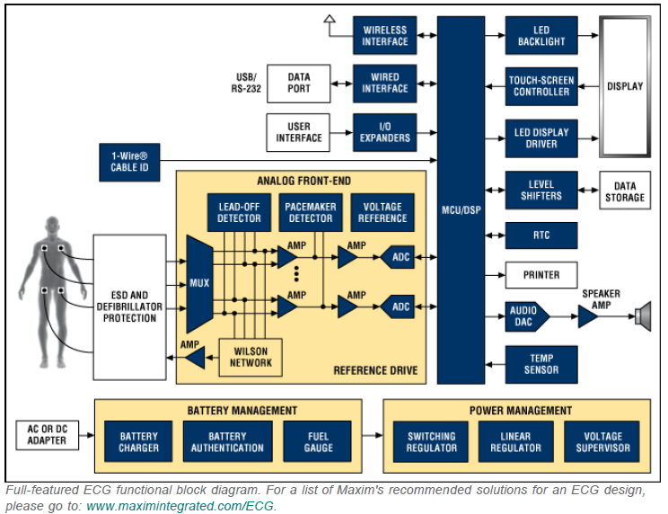
ECG Monitor
Introduction to Electrocardiograph, Maxim AN4693
https://www.maximintegrated.com/en/app-notes/index.mvp/id/4693
Funtional Block Diagram 2010

Slide 12
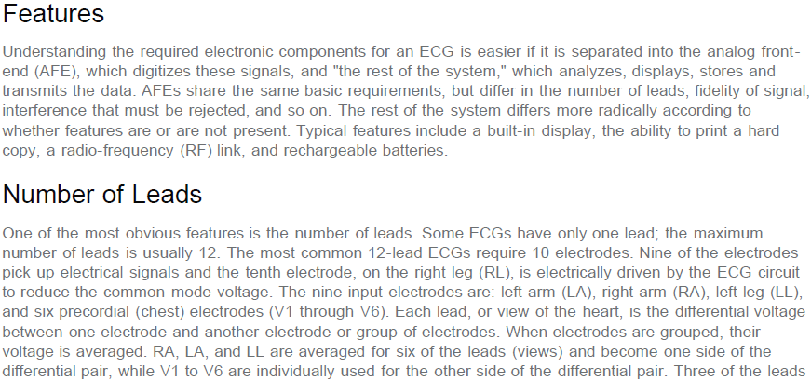
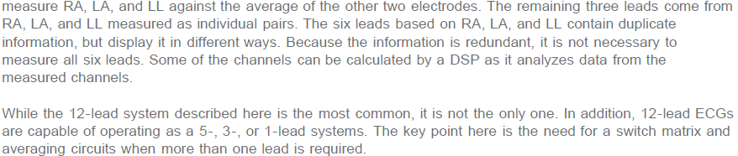
ECG Monitor
Introduction to Electrocardiograph, Maxim AN4693
https://www.maximintegrated.com/en/app-notes/index.mvp/id/4693

Slide 13
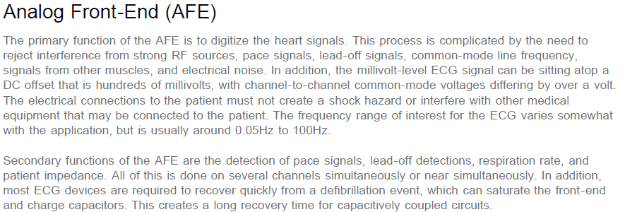
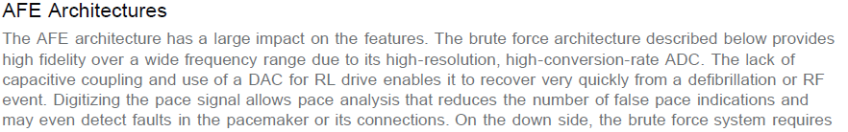
ECG Monitor
Introduction to Electrocardiograph, Maxim AN4693
https://www.maximintegrated.com/en/app-notes/index.mvp/id/4693

Slide 14
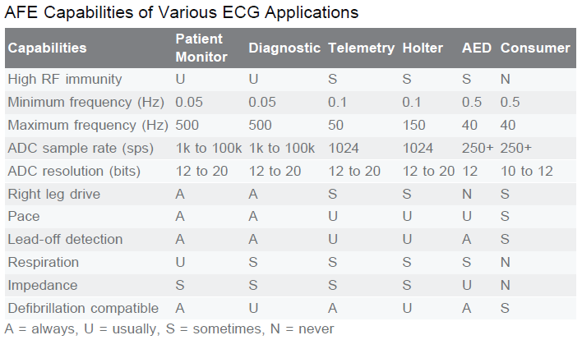
ECG Monitor
Introduction to Electrocardiograph, Maxim AN4693
https://www.maximintegrated.com/en/app-notes/index.mvp/id/4693

Slide 15
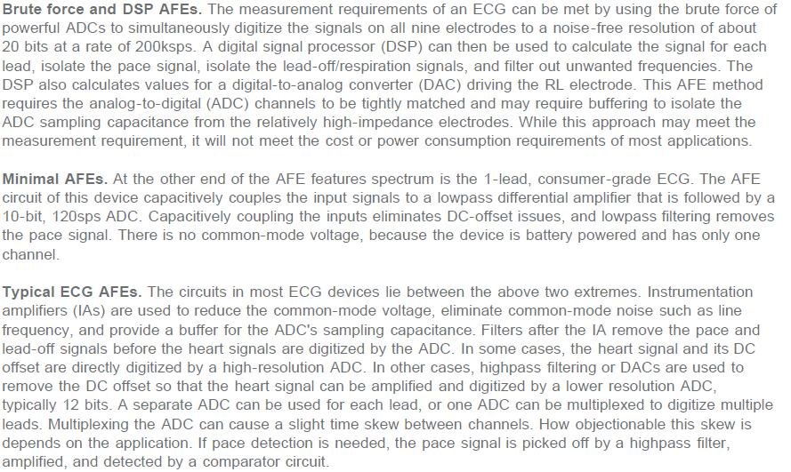
ECG Monitor
Introduction to Electrocardiograph, Maxim AN4693
https://www.maximintegrated.com/en/app-notes/index.mvp/id/4693

Slide 16



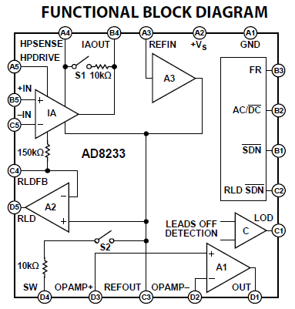
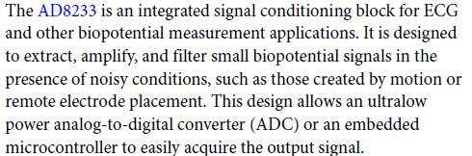
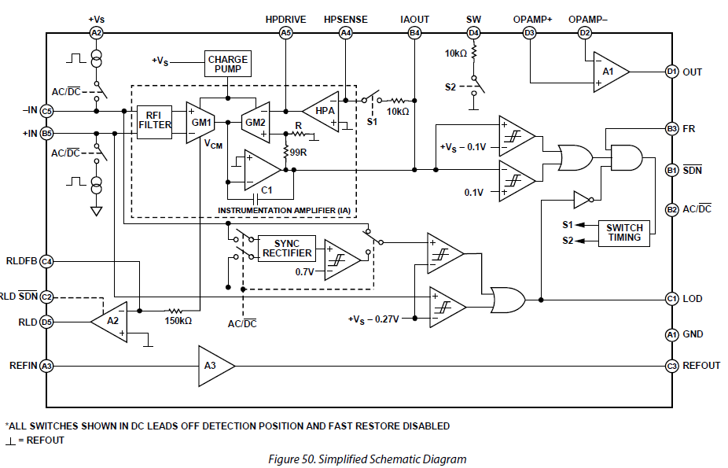
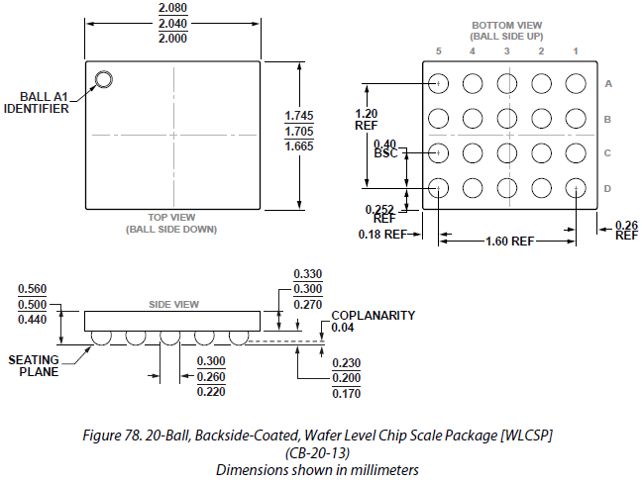
ECG Monitor
Analog Front End (AFE)
https://www.analog.com/media/en/technical-documentation/data-sheets/AD8233.pdf

Slide 17
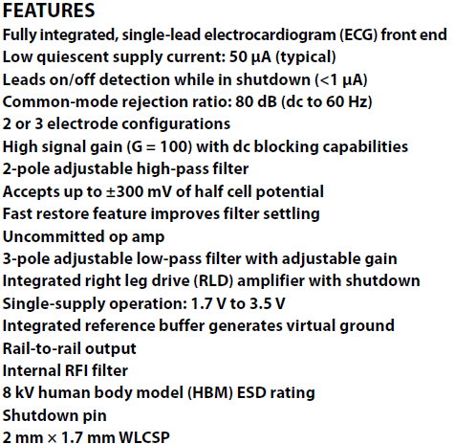
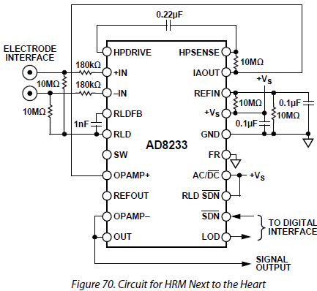
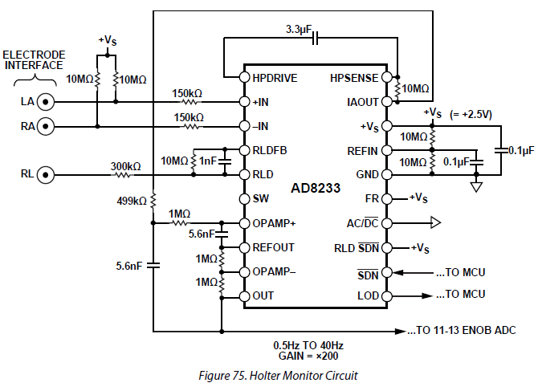
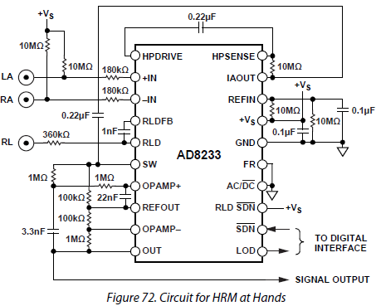
ECG Monitor
Analog Front End (AFE)

Slide 18
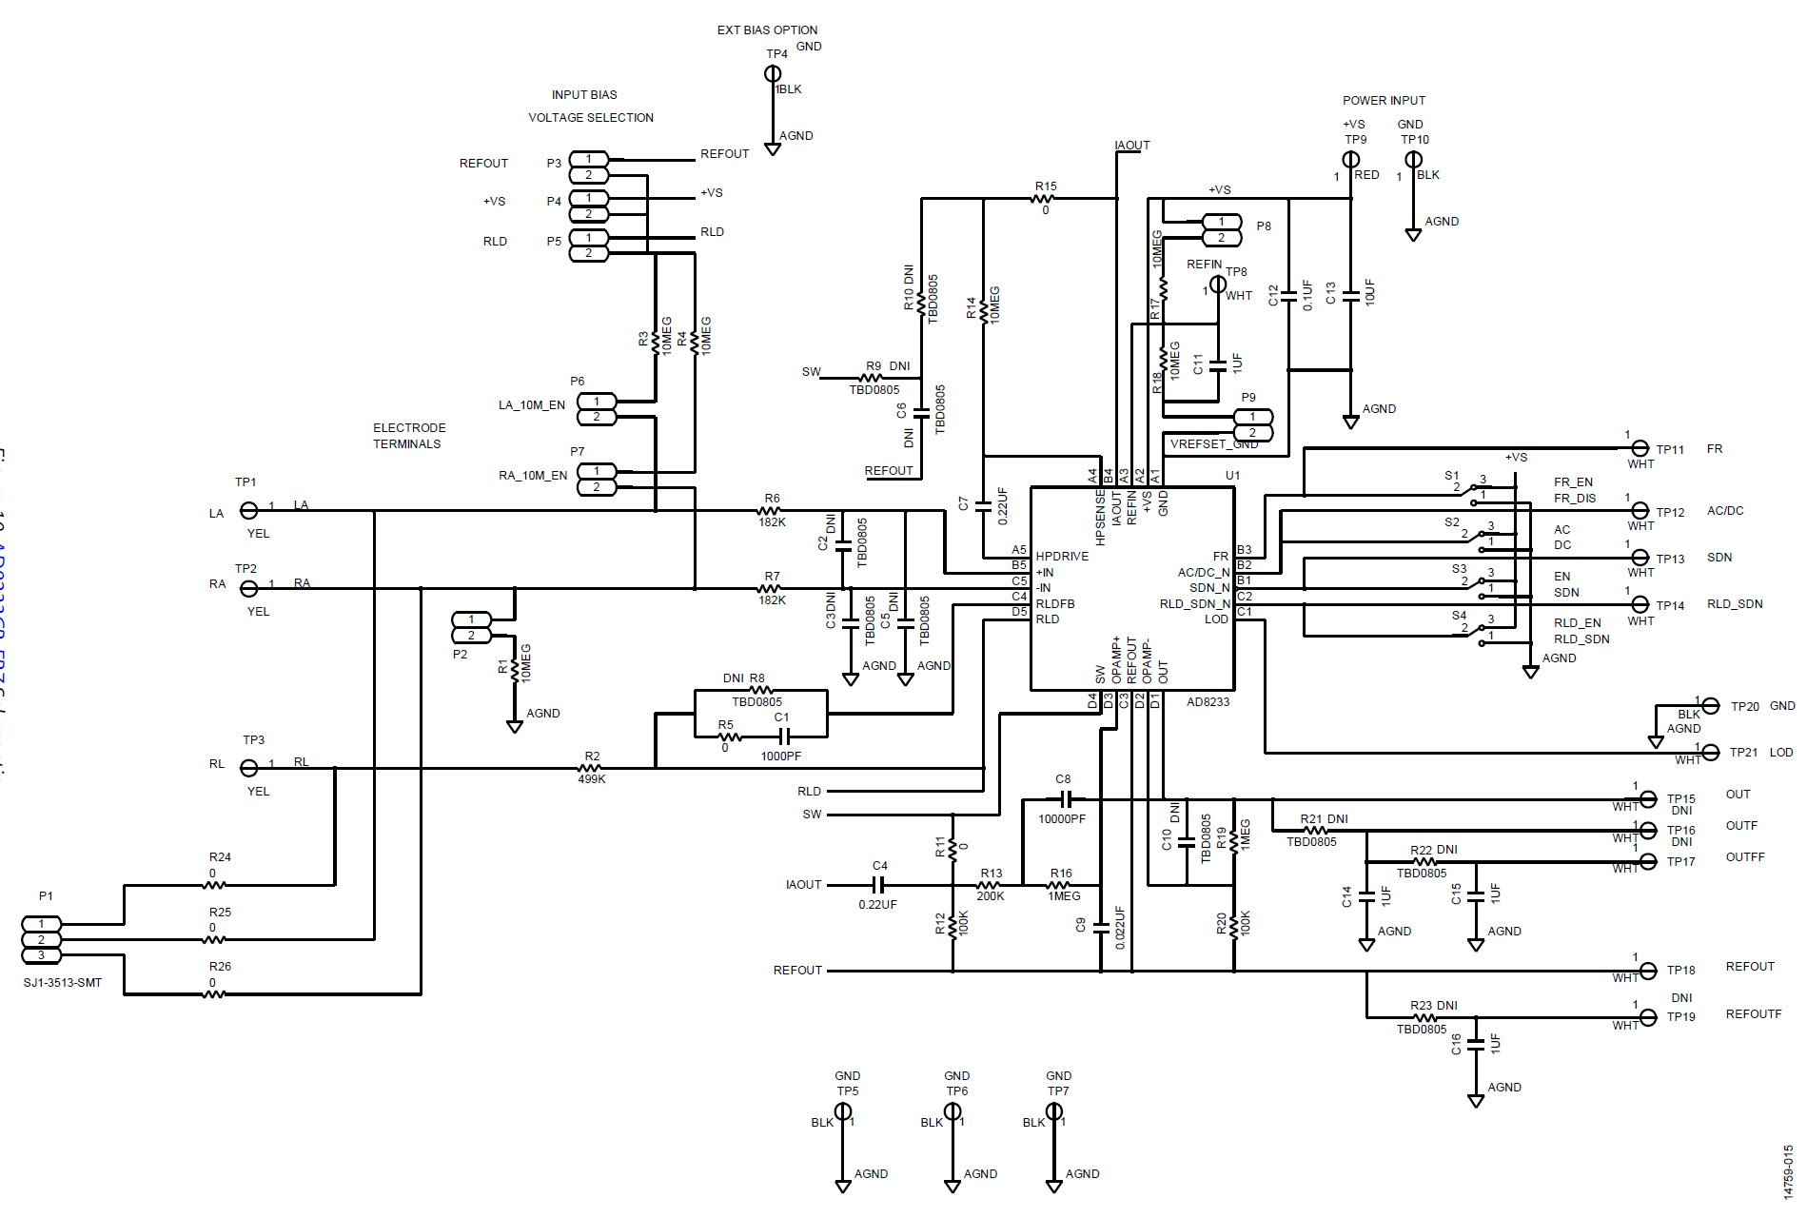
ECG Monitor
Analog Front End (AFE)
Example Schematic

Slide 19

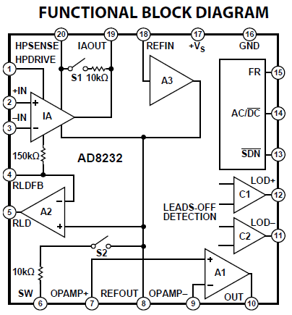
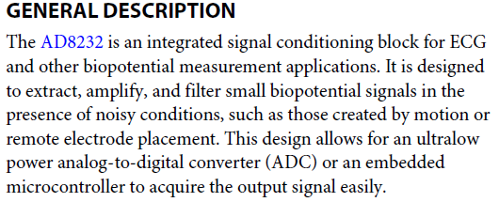
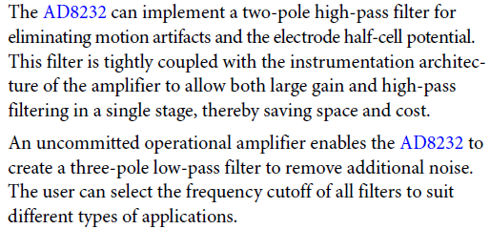
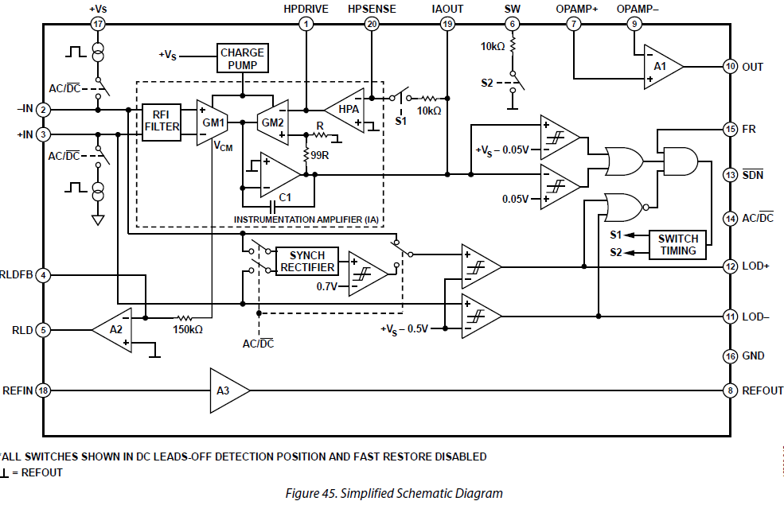
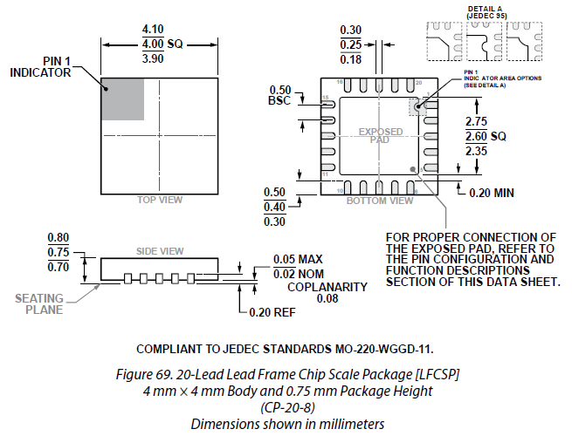
ECG Monitor
Analog Front End (AFE)
https://www.analog.com/media/en/technical-documentation/data-sheets/AD8233.pdf

Slide 20
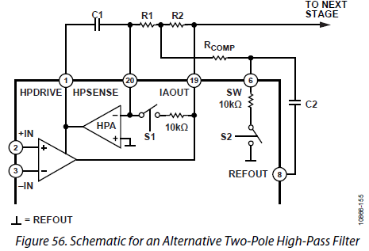
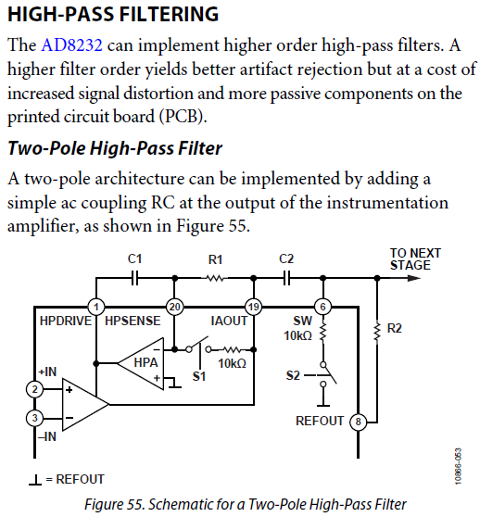
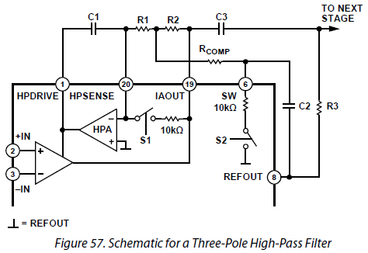
ECG Monitor
Analog Front End (AFE)

Slide 21
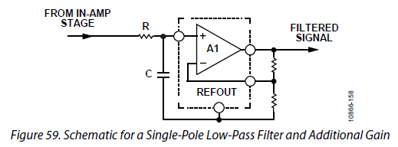
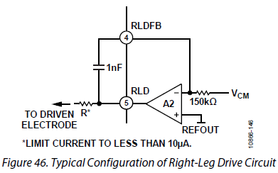
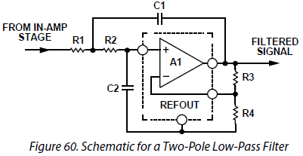
ECG Monitor
Analog Front End (AFE)

Slide 22
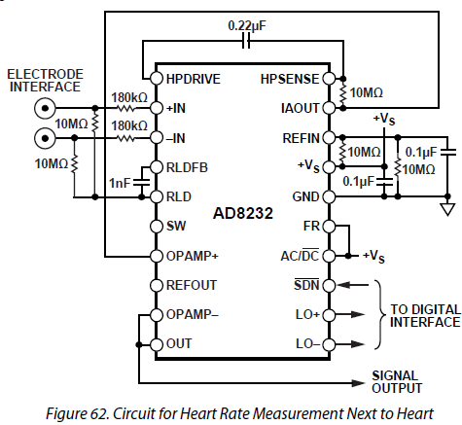
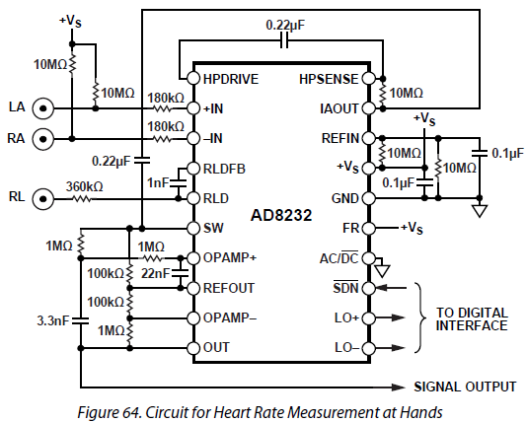
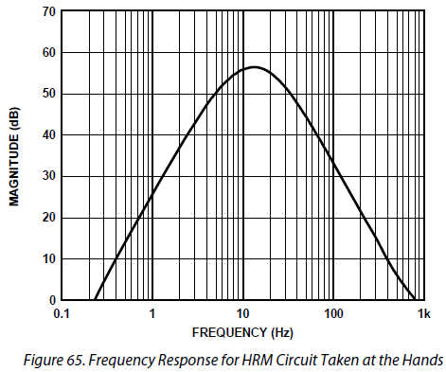
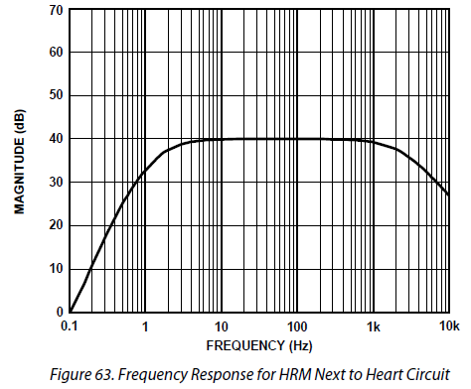
ECG Monitor
Analog Front End (AFE)

Slide 23
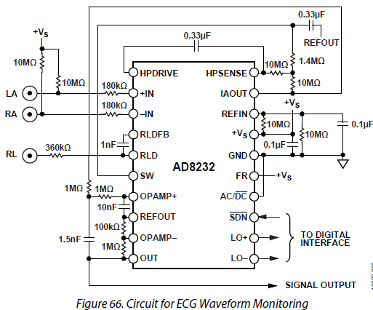
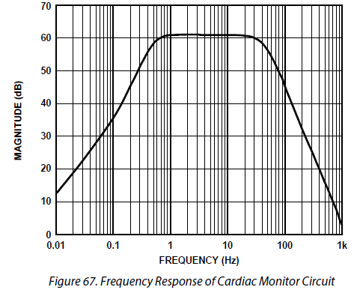
ECG Monitor
Analog Front End (AFE)

Slide 24
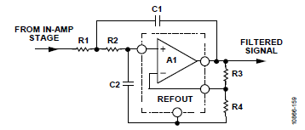



ECG Monitor
Analog Front End (AFE)
Cardiac monitor Configuration
MIKROE ECG 5
SparkFun AD8232
Filtro pasa bajo de dos polos para el AD8232
Tanto Sparkfun como MIKROE emplean:
R1 = R2 = R3 = 1 MΩ
R4 = 100 kΩ
C1 = 1,5 nF
C2 = 10 nF
fc = 41 Hz
GainLP = 11
Q = 0,77
Filtro pasa alto de dos polos para el AD8232
Formulas del filtro pasa bajo
Tanto Sparkfun como MIKROE emplean:
R1 = R2 = 10 MΩ
C1 = C2 = 0.33 μF
Rcomp = 1,4 MΩ
fc = 0,48 Hz
INA DC Gain = GainINA = 100
Total Gain = GainINA x GainLP
= 100 x 11 = 1100
= 60.83 dB
Formulas del filtro pasa alto

Slide 25




ECG Monitor
Analog Front End (AFE)
OEM example with AD8232
https://www.sparkfun.com/products/12650
https://github.com/sparkfun/AD8232_Heart_Rate_Monitor
SparkFun AD8232
Single Lead Heart Rate Monitor

Slide 26

ECG Monitor
Analog Front End (AFE)
OEM example with AD8232
SparkFun AD8232 Single Lead Heart Rate Monitor Schematic

Slide 27


ECG Monitor
Analog Front End (AFE)
OEM example with AD8232
SparkFun AD8232 Single Lead Heart Rate Monitor PCB
EasyEDA (Open hardware_Org)
https://easyeda.com/Sungchankim/Single_Lead_Heart_Rate_Monitor_AD8232_Open_hardware-2c0cavtPN_copy

Slide 28



ECG Monitor
Analog Front End (AFE)
OEM example with AD8232
SparkFun AD8232 Single Lead Heart Rate Monitor
Different Options

Slide 29




ECG Monitor
Analog Front End (AFE)
OEM example with AD8232
DFROBOT Gravity: Analog Heart Rate Monitor Sensor (ECG) For Arduino SKU:SEN0213
https://wiki.dfrobot.com/Heart_Rate_Monitor_Sensor_SKU__SEN0213
https://www.dfrobot.com/product-1510.html

Slide 30


ECG Monitor
Analog Front End (AFE)
OEM example with AD8232
DFROBOT Gravity: Analog Heart Rate Monitor Sensor (ECG) For Arduino SKU:SEN0213
https://wiki.dfrobot.com/Heart_Rate_Monitor_Sensor_SKU__SEN0213
https://www.dfrobot.com/product-1510.html

Slide 31



ECG Monitor
Analog Front End (AFE)
OEM example with AD8232: MIKROE ECG 5 Click
https://www.mikroe.com/ecg-5-click
ECG 5 click can be used for the development of ECG and Heart-Rate (HR) applications. The Click board™ features the AD8232, an integrated bio-signal front end. This IC has many features necessary for providing accurate ECG measurements, including very high common-mode rejection ratio, high gain with DC blocking capability, adjustable high-pass and low-pass filters, integrated right leg drive (RLD), etc. Electrodes presence detection pin helps to reduce the overall power consumption, as it can be used to set the standby mode of the host MCU. The fully conditioned bio-signal is available at the analog output to be sampled by an external A/D converter.

Slide 32

ECG Monitor
Analog Front End (AFE)
OEM example with AD8232
MIKROE ECG 5 Click Schematic

Slide 33



ECG Monitor
Analog Front End (AFE)
OEM example with ADS1194
https://www.mikroe.com/ecg-2-click
MIKROE ECG 2 click
ECG 2 click contains ADS1194 16-bit delta-sigma analog-to-digital converters from Texas Instruments, a built-in programmable gain amplifier (PGA), an internal reference, and an onboard oscillator.
The click communicates with the target MCU over SPI and the following mikroBUS pins: PWM, AN and INT. ECG 2 click runs on 3.3V and 5V power supply.

Slide 34
ECG Monitor
Analog Front End (AFE)
OEM example with ADS1294
MIKROE ECG 2 Click Schematic

Slide 35

ECG Monitor
SMD Passive Components
Surface-mount technology (SMT) is a method for producing electronic circuits in which the components are mounted or placed directly onto the surface of printed circuit board (PCBs).
An electronic device so made is called a surface-mount device (SMD)

Slide 36




ECG Monitor
Protection

Slide 37



ECG Monitor
Protection
https://www.microsemi.com/existing-parts/parts/137888
Features
• Protects Electrocardiographic (ECG) Monitoring Equipment
(ME) Against Effects of Defibrillation
• Very Small Size and Very Low Leakage
• Integrates Zener Diodes and SCRs into a Single IC
• Easily Expandable to M×5 Channels
• Facilitates Compliance with IEC 60601-2-25 and
IEC 60601-2-27
• Extremely Fast Turn-On
• Five Terminals Plus Substrates
• 28-Pin QFN Package
• Medical-Level Traceability
ZL70590
EKG/ECG
Surge Protection Device

Slide 38

ECG Monitor
Protection
Input Protection Examples

Slide 39


ECG Monitor
Protection
Consider Input Protection
Respuesta en frecuencia del circuito de protección (pasa bajo)
Bode de amplitud del circuito de protección. f3dB = 67.8 KHz

Slide 40




ECG Monitor
Protection

Slide 41

ECG Monitor
Discrete ECG Amplifier with INA
Right Leg

Slide 42

ECG Monitor
Discrete ECG Amplifier with INA
Right Leg and Protection

Slide 43



ECG Monitor
EMI Supression

Slide 44

ECG Monitor
EMI Supression

Slide 45



ECG Monitor
EMI Supression

Slide 46


ECG Monitor
EMI Supression

Slide 47

ECG Monitor
EMI Supression

Slide 48

ECG Monitor
EMI Supression

Slide 49



ECG Monitor
EMI Supression

Slide 50

ECG Monitor
EMI Supression

Slide 51
ECG Monitor
EMI Supression
EMI suppression
http://www.ti.com/lit/an/szza009/szza009.pdf
https://www.murata.com/products/emc/emifil/knowhow/basic
https://resources.altium.com/presentations/pcb-design-techniques-to-reduce-emi
https://resources.altium.com/ebooks/pcb-design-techniques-to-reduce-emi-ebook
https://resources.orcad.com/blog/techniques-to-reduce-emi-in-your-pcb-designs
https://www.eetimes.com/author.asp?section_id=36&doc_id=1327269#
Considerar las opciones Murata (Murata_EMILFIL_c31e-794748.pdf):
Ferrite Bead: BLM18PG121SN1
Capacitor Type: NFM18PS105D0J3
Common Mode Choque Coil: No

Slide 52
ECG Monitor
EMI Supression

Slide 53
ECG Monitor
EMI Supression

Slide 54

ECG Monitor
EMI Supression

Slide 55

ECG Monitor
EMI Supression

Slide 56
ECG Monitor
EMI Supression

Slide 57



ECG Monitor
EMI Supression
Consider 3 terminal capacitor for power supply
La inclusión de 3-terminal capacitor + capacitor (configuración π) para 3.3 V del conector mikroBus logra atenuar el ruido en frecuencias mayores a 100 KHz que incluye las frecuencias del microcontrolador de la aplicación. Además, protege del ruido de módulos de comunicaciones tipo WiFi y Bluetooth.
Respuesta del NFM18PS105D0J3D sin los condensadores
Configuración tipo $π con condensdadores$

Slide 58

ECG Monitor
Proyecto IIa con Proteus
Single Lead Heart Rate Monitor (based on AFE TI AD8232) Schematic (P8)

Slide 59
ECG Monitor
Proyecto IIa con Proteus
Single Lead Heart Rate Monitor (based on AFE TI AD8232) Schematic (P8)
Simulaciones:
Caso AD8232:
El modelo Spice no simula completamente el AD8232.
El modelo Spice fue modificado y se consiguió que:
Se produce una salida OUT con ganancia 900 @ 5 Hz y Voffset = 1.64 V.
Los pines del AD8232 que el modelo Spice no soporta correctamente son:
SW, AD_DC, SDN, LOD+, LOD-
Eliminar solo el cable conectado al pin SW:
Para que la simulación con osciloscopio digital funcione.
El modelo también funciona para el Bode de amplitud y fase de la ganancia modo diferencial.
Pero no funciona para el Bode de amplitud y fase de la ganancia modo común.
Exclude form Simulation para osciloscopio digital:
66226-008
BAS40W-04 (produce atenuación)
Exclude form Simulation para GRAPH de frecuencia (Bode de amplitud y fase de la ganancia modo diferencial):
Generador de ECG HDL
BAS40W-04
LED-RED
LED-GREEN
66226-008 (conector header macho)

Slide 60

ECG Monitor
Proyecto IIa con Proteus
Single Lead Heart Rate Monitor (based on AFE TI AD8232) Schematic (P8)
Bode de amplitud y fase de la ganancia modo diferencial Avd = Vo / Vid
Caso pasa bajo: fc = 43.6 Hz
Caso pasa alto: fc = 0.445 Hz.
Avd = 59,1 dB frecuencias medias

Slide 61

ECG Monitor
Proyecto IIa con Proteus
Single Lead Heart Rate Monitor (based on AFE TI AD8232) Schematic (P8)
Vid (onda senoidal 1 mVp @ 5 Hz) y Vo (OUT)

Slide 62

ECG Monitor
Proyecto IIa con Proteus
Single Lead Heart Rate Monitor (based on AFE TI AD8232) Schematic (P8)
. Vid (onda cuadrada 1 mVp @5 Hz) y Vo (OUT)

Slide 63

ECG Monitor
Proyecto IIa con Proteus
Single Lead Heart Rate Monitor (based on AFE TI AD8232) Schematic (P8)
Vid (ECG simulado 0.625 mVp) y Vo (OUT)

Slide 64

ECG Monitor
Proyecto IIa con Proteus
Single Lead Heart Rate Monitor (based on AFE TI AD8232) Schematic (P8)
BOM

Slide 65

ECG Monitor
Proyecto IIa con Proteus
Single Lead Heart Rate Monitor (based on AFE TI AD8232) Schematic (P8.3)

Slide 66

ECG Monitor
Proyecto IIa con Proteus
Single Lead Heart Rate Monitor basado en AFE TI AD8232 BOM (P8.3)

Slide 67

ECG Monitor
Proyecto IIa con Proteus
Single Lead Heart Rate Monitor basado en AFE TI AD8232 PCB Layout

Slide 68


ECG Monitor
Proyecto IIa con Proteus
Single Lead Heart Rate Monitor basado en AFE TI AD8232 3D Model

